Slide 1

Phylogenetic Trees
UPGMA: Unweighted Pair-Group Method with Arithmetic mean
Dr. Muhammad Tahir
Assistant Professor
COMSATS University Islamabad,
Attock Campus
NOTE: Most slides derived from

Slide 2
Phylogenetic Trees - Methods
There are several methods with which we construct trees and estimate how good a tree describes the data (and thus the evolution process)
Distance based methods
Parsimony
character based methods
Likelihood
Whole genome/proteome methods

Slide 3
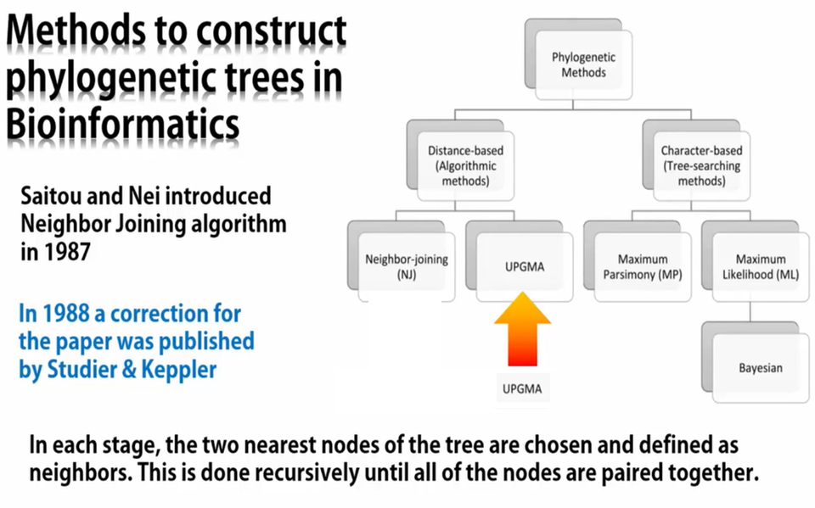
Phylogenetic Trees - Methods

Slide 4
UPGMA
UPGMA : Unweighted Pair Group Method with Arithmetic Mean
Developed by Sokal and Michener in 1958.
It is a Sequential clustering method
Type of distance-based method for Phylogenetic Tree construction
UPGMA is the simplest method for constructing trees.
Generates rooted trees
Generates ultra metric trees from a distance matrix
Uses a simplest algorithm
Input: Distance matrix containing pairwise statistical estimation of aligned sequences
Output: Phylogenetic tree

Slide 5
UPGMA Algorithm
UPGMA starts with a matrix of pairwise distances.
Each sample is denoted as a 'cluster'.
Assigns all clusters to a star-like tree.
The algorithm constructs a rooted tree that reflects the structure present in a pairwise similarity matrix.
At each step, the nearest two clusters are combined into a higher-level cluster.
It assumes an ultra-metric tree in which the distances from the root to every branch tip are equal.

Slide 6
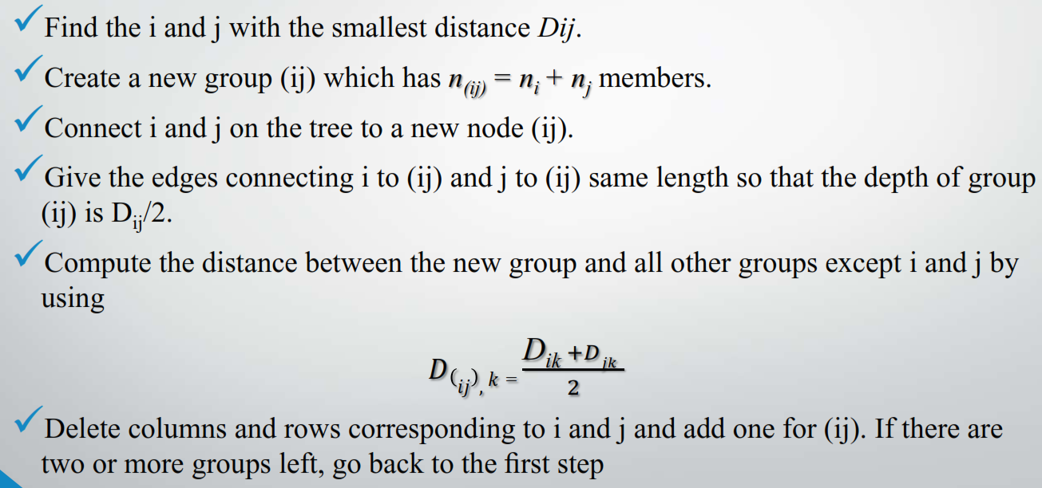
UPGMA Algorithm Steps

Slide 7
 | A | B | C | D | E | F | G
A
B | 19.00
C | 27.00 | 31.00
D | 8.00 | 18.00 | 26.00
E | 33.00 | 36.00 | 41.00 | 31.00
F | 18.00 | 1.00 | 32.00 | 17.00 | 35.00
G | 13.00 | 13.00 | 29.00 | 14.00 | 28.00 | 12.00
0.0
UPGMA: Unweighted Pair-Group Method with Arithmetic mean
Unweighted – all pairwise distances contribute equally.
Pair-Group – groups are combined in pairs (dichotomies only).
Arithmetic mean – pairwise distances to each group (clade) are mean distances to all members of that group.
(Ultrametric – assumes molecular clock)

Slide 8
 | A | B | C | D | E | F | G
A
B | 19.00
C | 27.00 | 31.00
D | 8.00 | 18.00 | 26.00
E | 33.00 | 36.00 | 41.00 | 31.00
F | 18.00 | 1.00 | 32.00 | 17.00 | 35.00
G | 13.00 | 13.00 | 29.00 | 14.00 | 28.00 | 12.00
B
F
0.5
0.5
0.0
0.5
1.0 / 2
0.5 + 0.5 = 1.0
1. Find the shortest pairwise distance.
2. Join two sequences/groups with shortest distance.
3. Depth of new branch = ½ shortest distance.
4. Tip-to-tip path length = shortest distance.

Slide 9
 | A | B | C | D | E | F | G
A
B | 19.00
C | 27.00 | 31.00
D | 8.00 | 18.00 | 26.00
E | 33.00 | 36.00 | 41.00 | 31.00
F | 18.00 | 1.00 | 32.00 | 17.00 | 35.00
G | 13.00 | 13.00 | 29.00 | 14.00 | 28.00 | 12.00
B
F
0.5
0.5
0.0
0.5
5. Calculate mean pairwise distances with other sequences in new matrix.
(19 + 18) / 2 = 18.5
(31 + 32) / 2 = 31.5
A
 | A | BF | C | D | E | G
A
BF | 18.50
C | 27.00 | 31.50
D | 8.00 | 17.50 | 26.00
E | 33.00 | 35.50 | 41.00 | 31.00
G | 13.00 | 12.50 | 29.00 | 14.00 | 28.00
C
B
F
D
(18 + 17) / 2 = 17.5
E
(36 + 35) / 2 = 35.5
G
(13 + 12) / 2 = 12.5

Slide 10
 | A | B | C | D | E | F | G
A
B | 19.00
C | 27.00 | 31.00
D | 8.00 | 18.00 | 26.00
E | 33.00 | 36.00 | 41.00 | 31.00
F | 18.00 | 1.00 | 32.00 | 17.00 | 35.00
G | 13.00 | 13.00 | 29.00 | 14.00 | 28.00 | 12.00
A
D
B
F
0.5
0.5
0.0
0.5
4.0
4.0
4.0
4.0 + 4.0 = 8.0
8.0 / 2
 | A | BF | C | D | E | G
A
BF | 18.50
C | 27.00 | 31.50
D | 8.00 | 17.50 | 26.00
E | 33.00 | 35.50 | 41.00 | 31.00
G | 13.00 | 12.50 | 29.00 | 14.00 | 28.00
6. Repeat cycle with new shortest distance.

Slide 11
 | A | B | C | D | E | F | G
A
B | 19.00
C | 27.00 | 31.00
D | 8.00 | 18.00 | 26.00
E | 33.00 | 36.00 | 41.00 | 31.00
F | 18.00 | 1.00 | 32.00 | 17.00 | 35.00
G | 13.00 | 13.00 | 29.00 | 14.00 | 28.00 | 12.00
A
D
B
F
0.5
0.5
0.0
0.5
4.0
4.0
4.0
 | A | BF | C | D | E | G
A
BF | 18.50
C | 27.00 | 31.50
D | 8.00 | 17.50 | 26.00
E | 33.00 | 35.50 | 41.00 | 31.00
G | 13.00 | 12.50 | 29.00 | 14.00 | 28.00

Slide 12
 | A | B | C | D | E | F | G
A
B | 19.00
C | 27.00 | 31.00
D | 8.00 | 18.00 | 26.00
E | 33.00 | 36.00 | 41.00 | 31.00
F | 18.00 | 1.00 | 32.00 | 17.00 | 35.00
G | 13.00 | 13.00 | 29.00 | 14.00 | 28.00 | 12.00
A
D
B
F
0.5
0.5
0.0
0.5
4.0
4.0
4.0
(19 + 18 + 18 + 17) / 4 = 18.0
 | AD | BF | C | E | G
AD
BF | 18.00
C | 26.50 | 31.50
E | 32.00 | 35.50 | 41.00
G | 13.50 | 12.50 | 29.00 | 28.00
B
A
F
D
C
(27 + 26) / 2 = 26.5
E
(33 + 31) / 2 = 32.0
(13 + 14) / 2 = 13.5
G

Slide 13
 | A | B | C | D | E | F | G
A
B | 19.00
C | 27.00 | 31.00
D | 8.00 | 18.00 | 26.00
E | 33.00 | 36.00 | 41.00 | 31.00
F | 18.00 | 1.00 | 32.00 | 17.00 | 35.00
G | 13.00 | 13.00 | 29.00 | 14.00 | 28.00 | 12.00
A
D
B
F
G
0.5
0.5
0.0
0.5
4.0
4.0
6.25
5.75
4.0
6.25
 | AD | BF | C | E | G
AD
BF | 18.00
C | 26.50 | 31.50
E | 32.00 | 35.50 | 41.00
G | 13.50 | 12.50 | 29.00 | 28.00
0.5 + 5.75 + 6.25 = 12.5
12.5 / 2

Slide 14
 | A | B | C | D | E | F | G
A
B | 19.00
C | 27.00 | 31.00
D | 8.00 | 18.00 | 26.00
E | 33.00 | 36.00 | 41.00 | 31.00
F | 18.00 | 1.00 | 32.00 | 17.00 | 35.00
G | 13.00 | 13.00 | 29.00 | 14.00 | 28.00 | 12.00
A
D
B
F
G
0.5
0.5
0.0
0.5
4.0
4.0
6.25
5.75
4.0
(19 + 18 + 13 + 18 + 17 + 14) / 6 = 16.5
6.25
 | AD | BFG | C | E
AD
BFG | 16.50
C | 26.50 | 30.67
E | 32.00 | 33.00 | 41.00
A
B
D
F
G
C
E
New distances are mean values for all possible pairwise distances between groups.

Slide 15
 | A | B | C | D | E | F | G
A
B | 19.00
C | 27.00 | 31.00
D | 8.00 | 18.00 | 26.00
E | 33.00 | 36.00 | 41.00 | 31.00
F | 18.00 | 1.00 | 32.00 | 17.00 | 35.00
G | 13.00 | 13.00 | 29.00 | 14.00 | 28.00 | 12.00
A
D
B
F
G
0.5
0.5
0.0
0.5
4.0
4.0
6.25
5.75
4.0
(19 + 18 + 13 + 18 + 17 + 14) / 6 = 16.5
6.25
 | AD | BFG | C | E
AD
BFG | 16.50
C | 26.50 | 30.67
E | 32.00 | 33.00 | 41.00
A
B
D
F
G
C
(31 + 32 + 29) / 3 = 30.67
(36 + 35 + 28) / 3 = 33.0
E

Slide 16
 | A | B | C | D | E | F | G
A
B | 19.00
C | 27.00 | 31.00
D | 8.00 | 18.00 | 26.00
E | 33.00 | 36.00 | 41.00 | 31.00
F | 18.00 | 1.00 | 32.00 | 17.00 | 35.00
G | 13.00 | 13.00 | 29.00 | 14.00 | 28.00 | 12.00
A
D
B
F
G
0.5
0.5
0.0
0.5
4.0
4.0
6.25
5.75
4.0
4.25
6.25
 | AD | BFG | C | E
AD
BFG | 16.50
C | 26.50 | 30.67
E | 32.00 | 33.00 | 41.00
2.0
8.25
0.5 + 5.75 + 4.25 = 16.5
16.5 / 2
4.0 + 4.25 +
6.25 + 2.0 = 16.5

Slide 17
 | A | B | C | D | E | F | G
A
B | 19.00
C | 27.00 | 31.00
D | 8.00 | 18.00 | 26.00
E | 33.00 | 36.00 | 41.00 | 31.00
F | 18.00 | 1.00 | 32.00 | 17.00 | 35.00
G | 13.00 | 13.00 | 29.00 | 14.00 | 28.00 | 12.00
A
D
B
F
G
0.5
0.5
0.0
0.5
4.0
4.0
6.25
5.75
4.0
(27 + 31 + 26 + 32 + 29) / 5 = 29.00
4.25
6.25
 | ADBFG | C | E
ADBFG
C | 29.00
E | 32.60 | 41.00
2.0
8.25
(33 + 36 + 31 + 35 + 28) / 5 = 32.60

Slide 18
 | A | B | C | D | E | F | G
A
B | 19.00
C | 27.00 | 31.00
D | 8.00 | 18.00 | 26.00
E | 33.00 | 36.00 | 41.00 | 31.00
F | 18.00 | 1.00 | 32.00 | 17.00 | 35.00
G | 13.00 | 13.00 | 29.00 | 14.00 | 28.00 | 12.00
A
D
B
F
G
C
0.5
0.5
0.0
0.5
4.0
4.0
6.25
5.75
4.0
4.25
6.25
 | ADBFG | C | E
ADBFG
C | 29.00
E | 32.60 | 41.00
2.0
8.25
14.5
6.25
14.5
29.0 / 2

Slide 19
 | A | B | C | D | E | F | G
A
B | 19.00
C | 27.00 | 31.00
D | 8.00 | 18.00 | 26.00
E | 33.00 | 36.00 | 41.00 | 31.00
F | 18.00 | 1.00 | 32.00 | 17.00 | 35.00
G | 13.00 | 13.00 | 29.00 | 14.00 | 28.00 | 12.00
A
D
B
F
G
C
0.5
0.5
0.0
0.5
4.0
4.0
6.25
5.75
4.0
(33 + 36 + 41 +31 + 35 + 28) / 6 = 34.00
4.25
6.25
 | ADBFGC | E
ADBFGC
E | 34.00
2.0
8.25
14.5
6.25
14.5

Slide 20
 | A | B | C | D | E | F | G
A
B | 19.00
C | 27.00 | 31.00
D | 8.00 | 18.00 | 26.00
E | 33.00 | 36.00 | 41.00 | 31.00
F | 18.00 | 1.00 | 32.00 | 17.00 | 35.00
G | 13.00 | 13.00 | 29.00 | 14.00 | 28.00 | 12.00
A
D
B
F
G
C
E
0.5
0.5
0.0
0.5
4.0
4.0
6.25
5.75
4.0
4.25
6.25
 | ADBFGC | E
ADBFGC
E | 34.00
2.0
8.25
14.5
UPGMA assumes a molecular clock. The tree is rooted with the final joining of clades. All tip-to-tip distances via the root will have the same total distance, equal to the final mean distance.
6.25
14.5
17.0
2.5
17.0

Slide 21
 | A | B | C | D | E | F | G
A
B | 19.00
C | 27.00 | 31.00
D | 8.00 | 18.00 | 26.00
E | 33.00 | 36.00 | 41.00 | 31.00
F | 18.00 | 1.00 | 32.00 | 17.00 | 35.00
G | 13.00 | 13.00 | 29.00 | 14.00 | 28.00 | 12.00
A
D
B
F
G
C
E
0.5
0.5
0.0
0.5
4.0
4.0
6.25
5.75
4.0
 | A | BF | C | D | E
BF | 18.50
C | 27.00 | 31.50
D | 8.00 | 17.50 | 26.00
E | 33.00 | 35.50 | 41.00 | 31.00
G | 13.00 | 12.50 | 29.00 | 14.00 | 28.00
4.25
6.25
2.0
8.25
14.5
 | AD | BF | C | E
BF | 18.00
C | 26.50 | 31.50
E | 32.00 | 35.50 | 41.00
G | 13.50 | 12.50 | 29.00 | 28.00
6.25
 | ADBFG | C
C | 29.00
E | 32.60 | 41.00
 | AD | BFG | C
BFG | 16.50
C | 26.50 | 30.67
E | 32.00 | 33.00 | 41.00
14.5
17.0
 | ADBFGC
E | 34.00
2.5
17.0

Slide 22
 | A | B | C | D | E | F | G
A
B | 19.00
C | 27.00 | 31.00
D | 8.00 | 18.00 | 26.00
E | 33.00 | 36.00 | 41.00 | 31.00
F | 18.00 | 1.00 | 32.00 | 17.00 | 35.00
G | 13.00 | 13.00 | 29.00 | 14.00 | 28.00 | 12.00
A
D
B
F
G
C
E
0.5
0.5
0.0
0.5
4.0
4.0
6.25
5.75
4.0
The source data for this worked example is a selection of Cytochrome C distances from Table 3 of one of the seminal phylogenetic papers: Fitch WM & Margoliash E (1967). Construction of phylogenetic trees. Science 155:279-84.
4.25
6.25
2.0
8.25
http://www.ncbi.nlm.nih.gov/pubmed/5334057
14.5
 | Turtle A | Man B | Tuna C | Chicken D | Moth E | Monkey F | DogG
Turtle
Man | 19
Tuna | 27 | 31
Chicken | 8 | 18 | 26
Moth | 33 | 36 | 41 | 31
Monkey | 18 | 1 | 32 | 17 | 35
Dog | 13 | 13 | 29 | 14 | 28 | 12
6.25
14.5
17.0
2.5
17.0

Slide 23
Vertebrates
Amniota
Reptilia
Mammals
Primates
Turtle
Chicken
Man
Monkey
Dog
Tuna
Moth
0.0
0.5
The UPGMA tree based on this Cytochrome C data supports the known evolutionary relationships of these organisms.
4.0
6.25
8.25
 | Turtle A | Man B | Tuna C | Chicken D | Moth E | Monkey F | DogG
Turtle
Man | 19
Tuna | 27 | 31
Chicken | 8 | 18 | 26
Moth | 33 | 36 | 41 | 31
Monkey | 18 | 1 | 32 | 17 | 35
Dog | 13 | 13 | 29 | 14 | 28 | 12
14.5
17.0

Slide 24
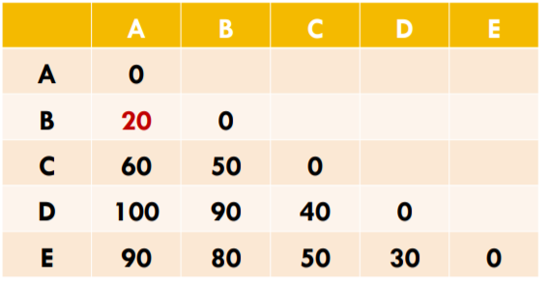
Homework/Assignment
Construct Phylogenetic Tree using UPGMA

Slide 25
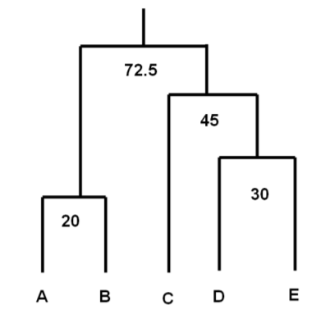
Homework/Assignment
Output

Slide 26
END

